Slide 1
Big Data Analytics 2021 Module 5 –Big Data Mining Algorithms
Clustering Approaches

Slide 2
Overview of the Chapter
What Is Clustering?
Challenges of Big Data Clustering
CURE Algorithm.

Slide 3
The Problem of Clustering
Given a set of points, with a notion of distance between points, group the points into some number of clusters, so that
Members of a cluster are close/similar to each other
Members of different clusters are dissimilar
Usually:
Points are in a high-dimensional space
Similarity is defined using a distance measure
Euclidean, Cosine, Jaccard, edit distance, …

Slide 4
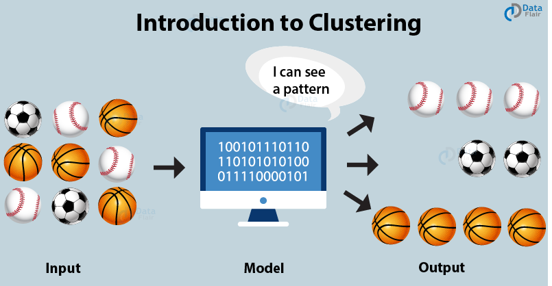
Example: Clusters & Outliers
x
xx x
x x
x x x
x
x x x
x
x
xx x
x x
x x x
x
x x x
x
x
x x
x x x x
x x x x
x x x
x x
x x
x x x x
x x x x
x x x
x x
x x
x x x x
x x x
x
x x
x x x x
x x x
x
x
Outlier
Cluster

Slide 5
Why is it hard?
Clustering in two dimensions looks easy
Clustering small amounts of data looks easy
Many applications involve not 2, but 10 or 10,000 dimensions
High-dimensional spaces look different: Almost all pairs of points are at about the same distance

Slide 6
Clustering Problem: Books
Intuitively: Books divides into categories, and customers prefer a few categories
But what are categories really?
Represent a Book by a set of customers who bought it:
Similar Books have similar sets of customers, and vice-versa

Slide 7
Clustering Problem: Books
Space of all Books:
Think of a space with one dim. for each customer
Values in a dimension may be 0 or 1 only
A book is a point in this space (x₁, x₂,…, x_{k}), where x_{i} = 1 iff the i ^{th} customer bought the book
For example Amazon Kindle, the dimension is tens of millions
Task: Find clusters of similar Books

Slide 8
Clustering Problem: Documents
Finding topics:
Represent a document by a vector (x₁, x₂,…, x_{k}), where x_{i} = 1 iff the i ^{th} word (in some order) appears in the document
It actually doesn’t matter if k is infinite; i.e., we don’t limit the set of words
Documents with similar sets of words may be about the same topic

Slide 9
Applications
Collaborative Filtering
Customer Segmentation
Data Summarization
Location Based Analysis
Multimedia Data Analysis
Biological Data Analysis
Social Network Analysis

Slide 10
Some Innovative Applications
Fake News Detection
Identification of Pre Cancerous Cancerous Non Cancerous Cells
Spam Filtering (Mail Grouping)
Clustering Algorithm in Search Engines
While searching for something particular on Google, you receive a mix of similar results that match to your original query.
This is a result of clustering that groups similar objects in a single cluster and provides that to you.

Slide 11
Applications
Wireless Networks
There are various clustering-based algorithms in wireless networks to improve their energy consumption and optimize data transmission.
Network Traffic Segmentation
You want to understand the different types of traffic coming to your website. You are particularly interested in understanding which traffic is spam or coming from bots.
Fraud Detection
Document Clustering

Slide 12
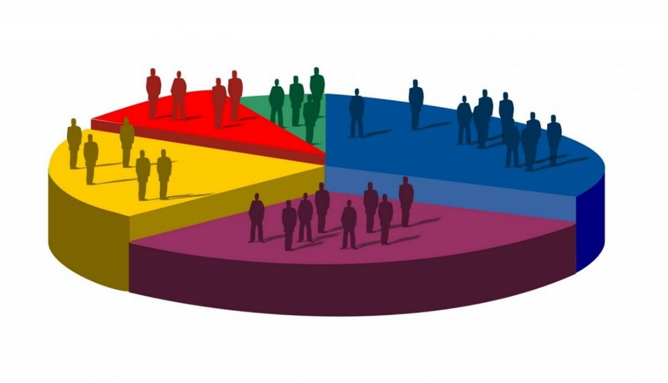
Applications - Market Segmentation
Based on the analysis of the user-base, companies are able to identify customers who would prove to be potential users for their product or services.
Customer browsing activity
Customer demographics
Recency, frequency, and monetary value of a customer
Items bought by a customer
Offline customer behavior

Slide 13
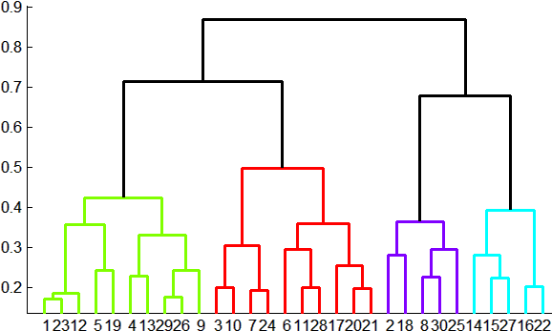
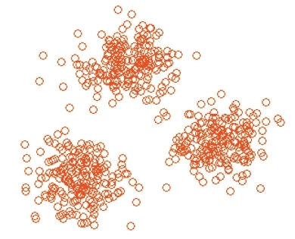
Overview: Methods of Clustering
Hierarchical:
Agglomerative (bottom up):
Initially, each point is a cluster
Repeatedly combine the two “nearest” clusters into one
Divisive (top down):
Start with one cluster and recursively split it
Point assignment:
Maintain a set of clusters
Points belong to “nearest” cluster

Slide 14
Curse of Dimensionality
Curse of Dimensionality refers to non-intuitive properties of data observed when working in high-dimensional space, specifically related to usability and interpretation of distances and volumes.
Most Big Data has too many dimensions
DNA mocrarray- gene sequeces
Text documents
Customer purchase data
Social Network Data
Movie Data
Crime Data
Customer Data

Slide 15
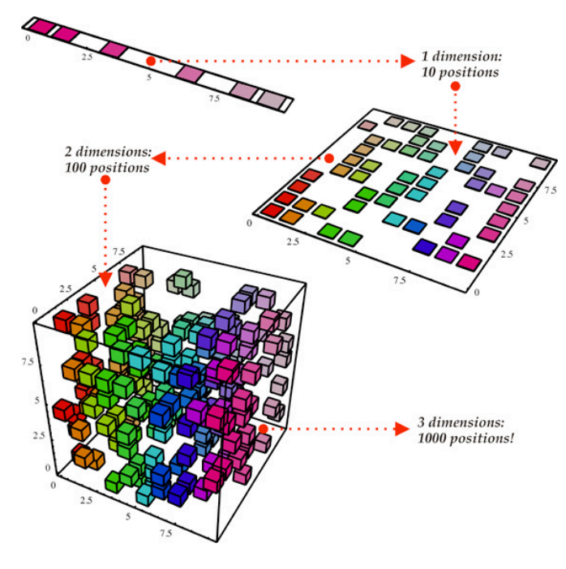
Curse of Dimensionality

Slide 16
Curse of Dimensionality
The Curse of Dimensionality - With one dimension (top left) there are only 10 possible positions therefore 10 data points are required to create a representative sample which 'covers' the problem space.
With two dimensions there are 10^2 = 100 possible positions therefore 100 data points are required to create a representative sample which 'covers' the problem space.
With just three dimensions there are now 10^3 = 1000 possible positions therefore 1000 data points are required to create a representative sample which 'covers' the problem space ...
This exponential growth in the required number of data points continues to grow exponentially indefinitely

Slide 17
The CURE Algorithm
Extension of k-means to clusters of arbitrary shapes

Slide 18
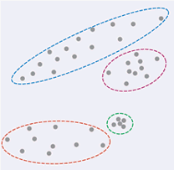
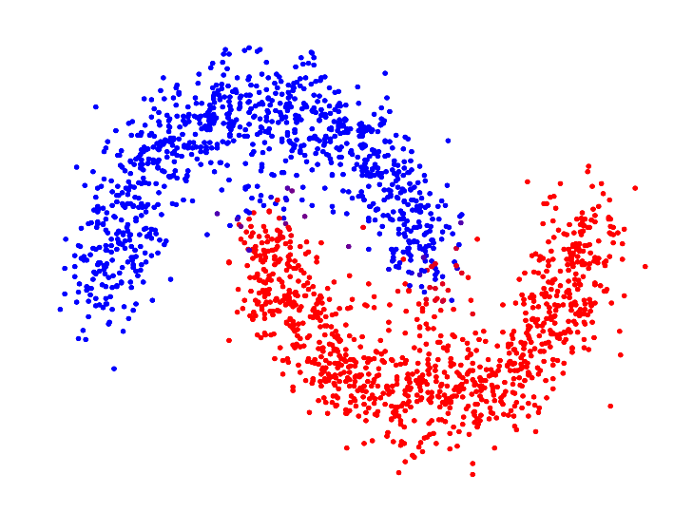
The CURE Algorithm
Vs.
Problem with k-means:
Assumes clusters are normally distributed in each dimension
And axes are fixed – ellipses at an angle are not OK
CURE (Clustering Using REpresentatives):
Assumes a Euclidean distance
Allows clusters to assume any shape
Uses a collection of representative points to represent clusters

Slide 19
Example: Stanford Salaries
h
h
h
e
e
e
h
e
e
e
h
e
e
e
e
salary
h
e
h
h
h
h
h
h
h
age

Slide 20
Overview
CURE uses random sampling and partitioning to reliably find clusters of arbitrary shape and size.
Clusters a random sample of the database in an agglomerative fashion, dynamically updating a constant number c of well-scattered points R1, . . . , Rc per cluster to represent each cluster’s shape.
To assign the remaining, unsampled points to a cluster, these points Ri are used in a similar manner to centroids in the k-means algorithm – each data point that was not in the sample is assigned to the cluster which contains the point Ri closest to the data point.
To handle large sample sizes, CURE divides the random sample into partitions which are pre-clustered independently, then the partially-clustered sample is clustered further by the agglomerative algorithm

Slide 21
Starting CURE
2 Pass algorithm. Pass 1:
0) Pick a random sample of points that fit in main memory
1) Initial clusters:
Cluster these points hierarchically – group nearest points/clusters
2) Pick representative points:
For each cluster, pick a sample of points, as dispersed as possible
From the sample, pick representatives by moving them (say) 20% toward the centroid of the cluster

Slide 22
Example: Initial Clusters
h
h
h
e
e
e
h
e
e
e
h
e
e
e
e
h
salary
e
h
h
h
h
h
h
h
age

Slide 23
Example: Pick Dispersed Points
h
h
h
e
e
e
h
e
e
e
h
e
e
e
e
h
salary
e
Pick (say) 4
remote points
for each
cluster.
h
h
h
h
h
h
h
age

Slide 24
Example: Pick Dispersed Points
h
h
h
e
e
e
h
e
e
e
h
e
e
e
e
h
salary
e
Move points
(say) 20%
toward the
centroid.
h
h
h
h
h
h
h
age

Slide 25
CURE algorithm
Step by step
For each cluster, c well scattered points within the cluster are chosen, and then shrinking them toward the mean of the cluster by a fraction α
The distance between two clusters is then the distance between the closest pair of representative points from each cluster.
The c representative points attempt to capture the physical shape and geometry of the cluster. Shrinking the scattered points toward the mean gets rid of surface abnormalities and decrease the effects of outliers.

Slide 26
Finishing CURE
Pass 2:
Now, rescan the whole dataset and visit each point p in the data set
Place it in the “closest cluster”
Normal definition of “closest”: Find the closest representative to p and assign it to representative’s cluster
p

Slide 27




CURE
Choosing well ‘scattered points’ representative of the cluster’s shape allows more precision than a standard spheroid radius.
α
Shrinking the sets, increases the distance from each cluster to any outlier, possibly the distance beyond the threshold and, mitigating the ‘chaining’ effect.

Slide 28
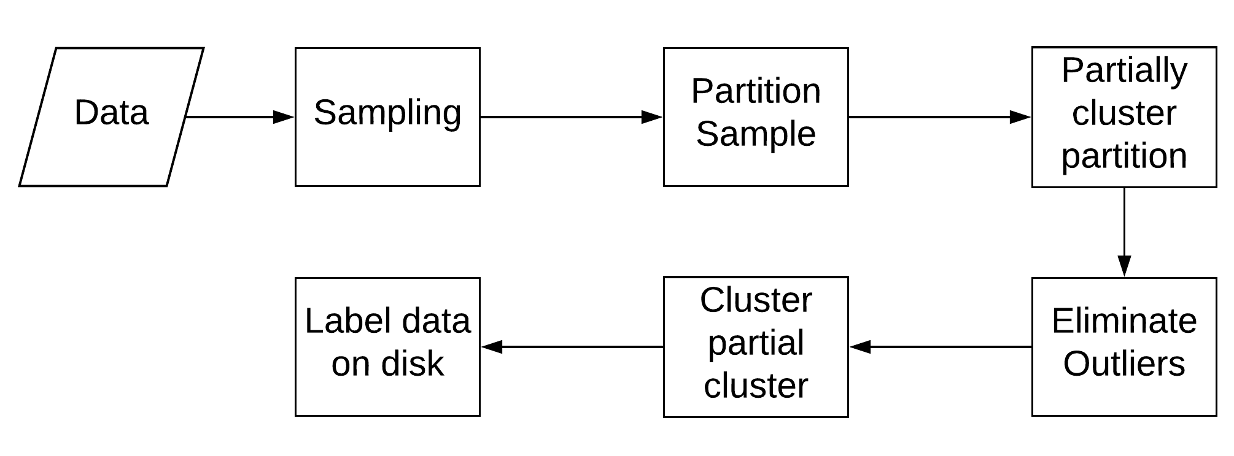
CURE phases

Slide 29
CURE
CURE uses a k-d tree and a priority queue to process the clusters.
The k-d tree is used to retrieve the closest cluster for a given cluster, the search operation has a time complexity of O(log n).
The priority queue stores the list of clusters ordered with respect to the distance of a given cluster to its closest cluster.
The algorithm runs till the number of clusters in the queue equals to the number of clusters required. The algorithm has a time complexity of O(n²log n) and a space complexity of O(n).

Slide 30
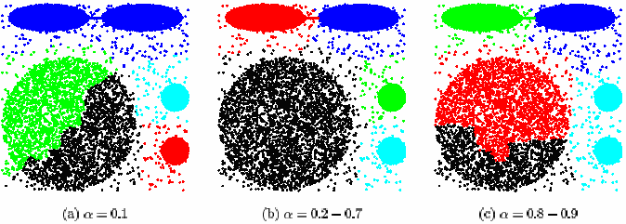
CURE algorithm
Experimental results
Shrink Factor α:
0.2 – 0.7 is a good range of values for α

Slide 31
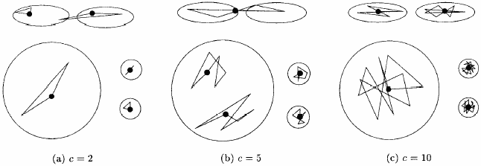
CURE algorithm -Experimental results
Number of representative points c:
For smaller values of c, the quality of clustering suffered
For values of c greater than 10, CURE always found right clusters

Slide 32
CURE (no. of points, k) Input : A set of points S ; Output : k clusters
For every cluster u (each input point), in u.mean and u.rep store the mean of the points in the cluster and a set of c representative points of the cluster (initially c = 1 since each cluster has one data point). Also u.closest stores the cluster closest to u.
All the input points are inserted into a k-d tree T
Treat each input point as separate cluster, compute u.closest for each u and then insert each cluster into the heap Q. (clusters are arranged in increasing order of dist between u & u.closest).
While size (Q) > k
Remove the top element of Q (say u) and merge it with its closest cluster u.closest (say v) and compute the new representative points for the merged cluster w.
Remove u and v from T and Q.
For all the clusters x in Q, update x.closest and relocate x
insert w into Q {repeat the process}

Slide 33
Data Partitioning and Clustering
s = 50
p = 2
s/p = 25
s/pq = 5
y
y
y
x
y
y
x
x
x
x

Slide 34
Cure: Shrinking Representative Points
y
y
x
x
Shrink the multiple representative points towards the gravity center by a fraction of α.
Multiple representatives capture the shape of the cluster

Slide 35
CURE – Very Large Datasets
Random sampling : random sampling supports large data sets. Generally the random sample fits in main memory.
Partitioning : The basic idea is to partition the sample space into p partitions. Each partition contains n/p elements.
The first pass partially clusters each partition until the final number of clusters reduces to n/pq for some constant q ≥ 1.
A second clustering pass on n/q partially clusters partitions.
For the second pass only the representative points are stored since the merge procedure only requires representative points of previous clusters before computing the representative points for the merged cluster.
Labeling data on disk : Given only representative points for k clusters, the remaining data points are also assigned to the clusters. For this a fraction of randomly selected representative points for each of the k clusters is chosen and data point is assigned to the cluster containing the representative point closest to it.

Slide 36
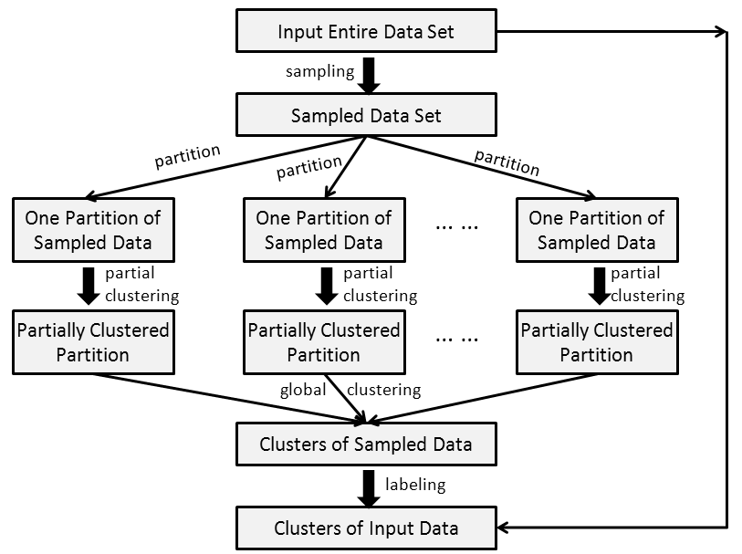
CURE – Distributed Version

